Slide 1
Chapter 1: Explore the Network
Introduction to Networks v6.0
Notes:
Cisco Networking Academy Program
Introduction to Networks v6.0
Chapter 1: Explore the Network

Slide 2
Chapter 1 - Sections & Objectives
1.1 Globally Connected
Explain how networks affect the way we interact, learn, work, and play.
Explain how host devices can be used as clients, servers, or both.
1.2 LANs, WANs, and the Internet
Explain the use of network devices.
Compare the devices and topologies of a LAN to the devices and topologies of a WAN.
Describe the basic structure of the Internet.
Explain how LANs and WANs interconnect to the Internet.
1.3 The Network as a Platform
Explain the concept of a converged network.
Describe the four basic requirements of a reliable network.
1.4 The Changing Network Environment
Explain how trends such as BYOD, online collaboration, video, and cloud computing are changing the way we interact.
Explain how networking technologies are changing the home environment.
Identify basic security threats and solutions for both small and large networks.
Describe the importance of understanding the underlying switching and routing infrastructure of a network.
Notes:
2

Slide 3
1.1 Globally Connected
Notes:
Cisco Networking Academy Program
Introduction to Networks v6.0
Chapter 1: Explore the Network

Slide 4


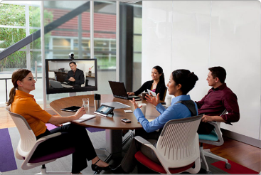
Globally Connected Networking Today
Network has no boundary and supports the way we:
Learn
Communicate
Work
Play
Notes:
1.1 – Globally Connected
1.1.1 – Network Today

Slide 5
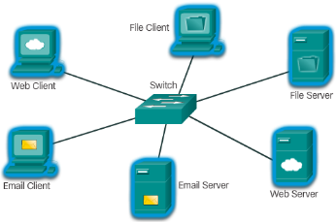
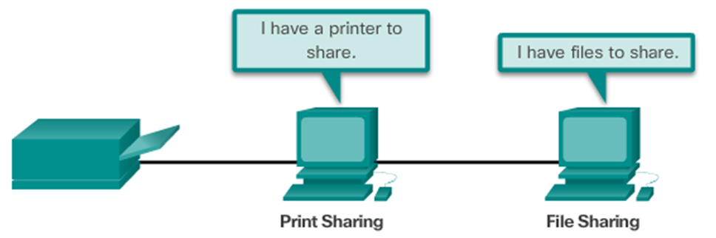
Globally Connected Providing Resources in a Network
Networks of Many Sizes
Small Home / Office Networks
Medium to Large Networks
World Wide Network
Clients and Servers
Clients request and display information
Servers provide information to other devices on the network
Peer-to-Peer
Computers can be both server and client at the same time.
What are the advantages?
What are the disadvantages?
Notes:
1.1 – Globally Connected
1.1.2 – Providing Resources in a Network

Slide 6
1.2 LANs, WANs, and the Internet
Notes:
Cisco Networking Academy Program
Introduction to Networks v6.0
Chapter 1: Explore the Network

Slide 7
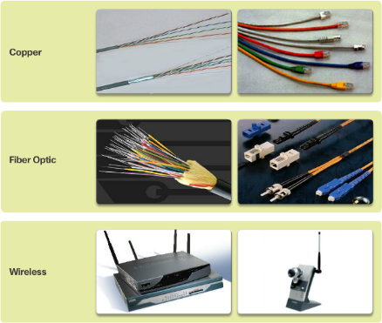
LANs, WANs, and the Internet Network Components
End Devices
Either the source or destination of a message
Name some end devices
Intermediary Network Devices
Connect multiple individual networks to form an internetwork
Connect the individual end devices to the network
Ensure data flows across the network
Provide connectivity
Network Media
Provide the pathway for data transmission
Interconnect devices
Name the three types of media
Notes:
1.2 – LANs, WANs, and the Internet
1.2.1 – Network Components

Slide 8






LANs, WANs, and the Internet Network Components
Network Representations
What do the symbols represent?
Topology Diagrams
Physical
Logical
Notes:
1.2 – LANs, WANs, and the Internet
1.2.1 – Network Components

Slide 9
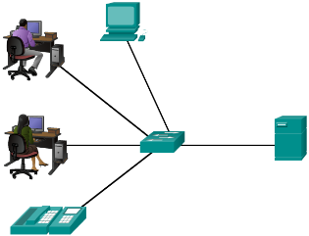
LANs, WANs, and the Internet LANs and WANs
Local Area Networks
Spans across small geographical area
Interconnects end devices
Administrated by a single organization
Provide high speed bandwidth to internal devices
WAN Area Networks
Interconnects LAN
Administrated by multiple service providers
Provide slower speed links between LANS
Can you name more network types?
Notes:
1.2 – LANs, WANs, and the Internet
1.2.2 – LANs and WANs

Slide 10
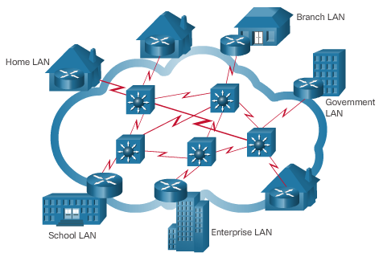
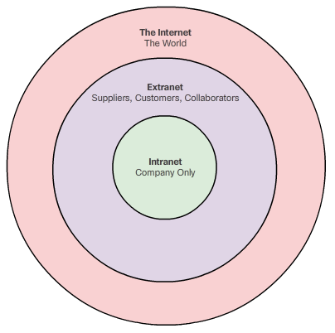
LANs, WANs, and the Internet The Internet, Intranets, and Extranets
The Internet
Worldwide collection of interconnected networks
Not owned by any individual or group
Intranets and Extranets
Notes:
1.2 – LANs, WANs, and the Internet
1.2.3 – The Internet, Intranets, and Extranets

Slide 11
LANs, WANs, and the Internet Internet Connections
Internet Access Technologies
Internet Service Provider (ISP)
Broadband cable
Broadband Digital Subscriber Line (DSL)
Wireless WANs
Mobile Services
Business DSL
Leased Lines
Metro Ethernet
Types of Internet Connections
Home and Small Office
Business
Notes:
1.2 – LANs, WANs, and the Internet
1.2.4 – Internet Connections

Slide 12
1.3 The Network as a Platform
Notes:
Cisco Networking Academy Program
Introduction to Networks v6.0
Chapter 1: Explore the Network

Slide 13
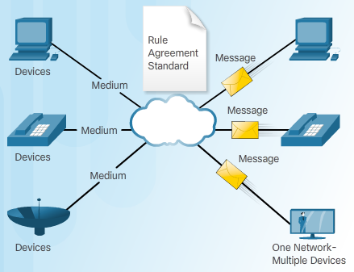
The Network as a Platform Converged Networks
Traditional Separate Networks
Each network with its own rules and
The Converging Network
Capable of delivering data, voice, and video over the same network infrastructure
Notes:
1.3 – The Network as a Platform
1.3.1 – Converged Networks

Slide 14
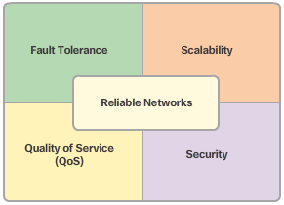
The Network as a Platform Reliable Network
Four Basic Characteristics of Network Architecture
Fault Tolerance
Scalability
Quality of Service (QoS)
Security
Notes:
1.3 – The Network as a Platform
1.3.2 – Reliable Network

Slide 15
1.4 The Changing Network Environment
Notes:
Cisco Networking Academy Program
Introduction to Networks v6.0
Chapter 1: Explore the Network

Slide 16

The Changing Network Environment Network Trends
Top trends include:
Bring Your Own Device (BYOB)
Online Collaboration
Video Communications
Cloud Computing
Notes:
1.4 – The Changing Network Environment
1.4.1 – Network Trends

Slide 17

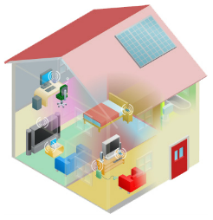
The Changing Network Environment Networking Technologies for the Home
Technology Trends in the Home
Smart home
Powerline Networking
Uses existing electrical wiring to connect devices
Wireless Broadband
Wireless Internet Service Provider (WISP)
Wireless Broadband Service using cellular technology
Notes:
1.4 – The Changing Network Environment
1.4.2 - Networking Technologies for the Home

Slide 18
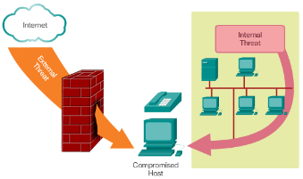
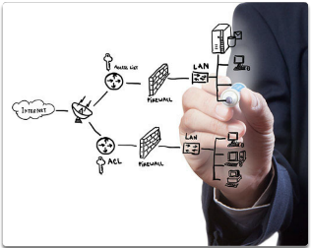
The Changing Network Environment Network Security
Security Threats
Viruses, worms, and Trojan horses
Spyware and adware
Zero-day attacks, also called zero-hour attacks
Hacker attacks
Denial of service attacks
Data interception and theft
Identity theft
Security Solutions
Antivirus and antispyware
Firewall filtering
Dedicated firewall systems
Access control lists (ACL)
Intrusion prevention systems (IPS)
Virtual Private Networks (VPNs)
Notes:
1.4 – The Changing Network Environment
1.4.3 – Network Security

Slide 19
1.5 Chapter Summary
Notes:
Cisco Networking Academy Program
Introduction to Networks v6.0
Chapter 1: Explore the Network

Slide 20
Chapter Summary Summary
Explain how multiple networks are used in everyday life.
Describe the topologies and devices used in a small to medium-sized business network.
Explain the basic characteristics of a network that supports communication in a small to medium-sized business.
Explain trends in networking that will affect the use of networks in small to medium-sized businesses.
Notes:
1.5.1.3 - Summary

Slide 21


